Slide 1
Capabilities presentation
Rev. 2015-11-24

Slide 2
Pull up a seat
We work like a full-service agency without the overhead. You pay for the team when you need it, not if you need it.
We’re not a marketing firm, advertising agency or boutique studio. We’re your Creative Department. We’re an extension of your in-house team or we’re your only team. We work on your deadlines no matter what.
We care about developing innovative marketing solutions that meet our your objective mixed with a culture of “getting it done.”
Our array of creative services lie on a spectrum from branding, lead generation, digital, and campaign planning.

Slide 3
A little more about us
Mission
Remain lean, accessible, deadline-oriented. We are a hub for amazing people that believe in creativity and see possibilities on a blank sheet of paper. We have a passion for creative problem solving and can effectively respond to our clients’ need for a results-generating creative product within a reasonable cost structure.
Values
What we care about is creating innovative solutions for our clients. Solutions that engage. Solutions that inspire. Solutions that get results. Our array of services lie on a spectrum from graphic & web design to advertising, and we also combine talent with a culture of “getting it done.”

Slide 4
Core competencies

Slide 5
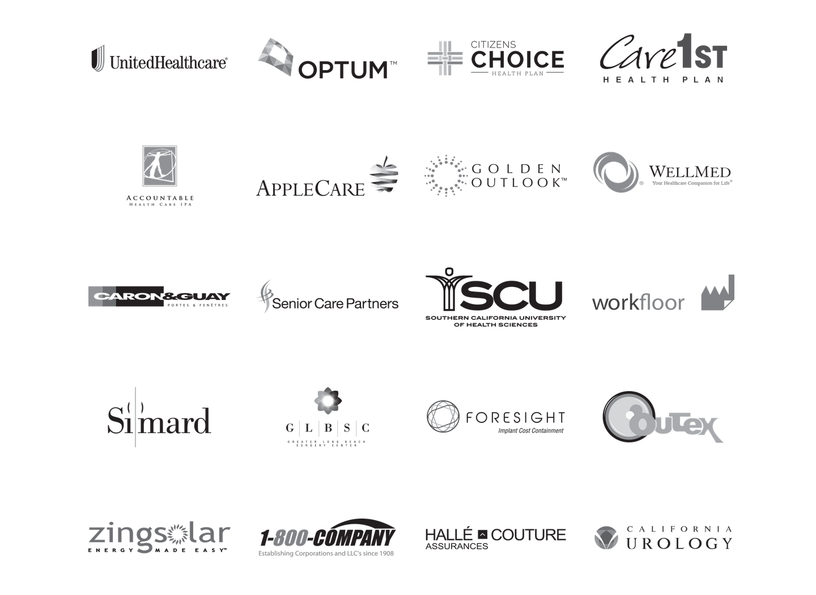
Clients and old friends

Slide 6
Meet our team
Principals
Mike Thompson
David Morin
Finance
Robert Bates Matthew Williams
Print and Fulfillment
Sally Michauld
Sam Patel
Media
Ian Crockett
Creative
David Morin
Lam Ngo
Cade Garrett
Ingrid Salinas
Teresa Colon
Digital
Matt Kovach
Phuc Nguyen
Courtney Smith
Alex Hernandez
Legal
Matt LaCroix
Accounts
Mike Thompson
Marlyn Becerra
Chandler Sant
Annie Rusk
Mykaela Ward
Copy and Proofreading
Kim Chow
Jonathan Miracle

Slide 7
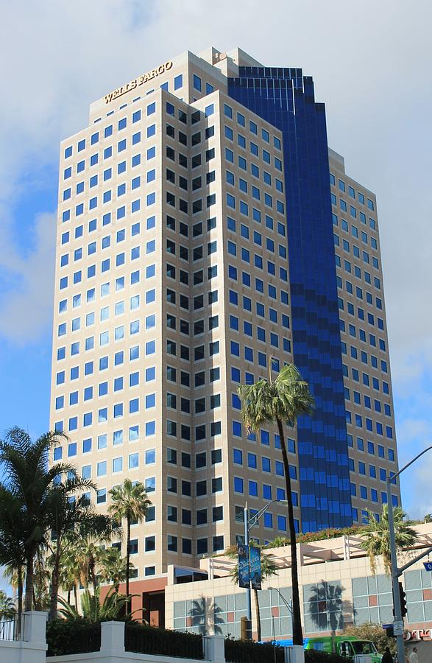
Pine and Ocean–Downtown Long Beach, CA

Slide 8
Awards
2015
Best in show W3 Award Best homepage design
Bronze Telly Award Best local TV and local cable
Bronze Peoples Telly Award Best use of humor
Silver Summit International Award Retail television
Bronze Summit International Award Local television spot
Gold Communicator Award Commercials Retail store/Specialty store
Gold Communicator Award Commercials Use of humor
Gold Communicator Award Outdoor Advertising campaign
2014
Silver Telly Award Best local TV and local cable
Bronze Telly Award Best use of humor
Bronze People Telly Award Best use of humor
Gold Davey Award Best design
Silver Davey Award Best local TV and local cable
Silver Davey Award Best use of humor
Silver Summit Award Best local TV and local cable
Silver Summit Award Best use of humor
Silver Addy Award Best local TV and local cable
Gold W3 Award Best user experience
Silver W3 Award Best homepage design

Slide 9
Healthcare experience
Seasonality and initiatives
OEP and SEP (Lock in)
Turning 65 (Commercial to MAPD)
Physician and Clinic support
Health plan and hospital affiliation
Network and IPA affiliation
Broker and agent support
OEP and SEP (Lock in)
FMO relationship management
Sales and support center integration
Co-branded
Duals / Medi-Medi
Formats
Campaign planning
Direct mail
Radio
Outdoor
Print
FSI
Facebook / Google
Landing page

Slide 10
Industry experience
Healthcare
Optum / United Health Group (2013+)
AllCare IPA (2015+)
New York Proton Center (2016)
ProHealth (2015-2016)
Golden Outlook Insurance Services (2012 +)
WellMed Medical Group (2013-2015)
Citizens Choice Health plan (2011-2015)
Higher Education
Southern California University Health Sciences (2008+)
Chapman University (2013-2015)
PADI (2013)
Consumer Packaged Goods / Retail (CPG)
AQUAhydrate (2013-2015) / VC from Yucaipa Companies
Vizio (2014)
Outex (2013+)
Simard (2010)

Slide 11
Acquisition assistance
Notes:
Need Monarch and SMA

Slide 12
Portfolio

Slide 13
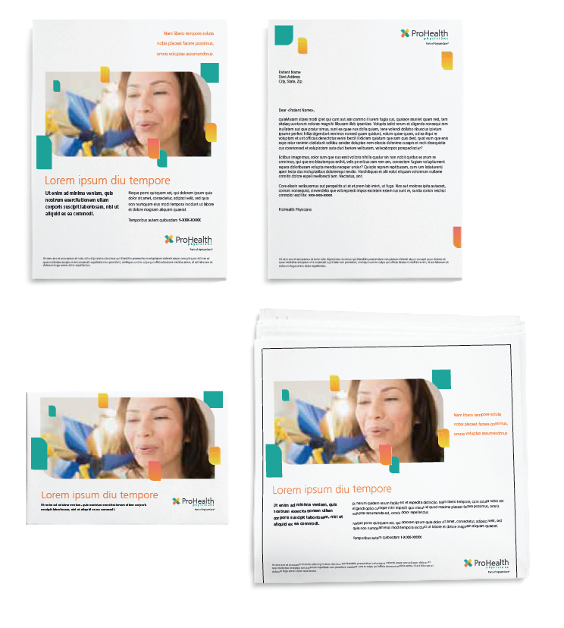
ProHealth Physicians

Slide 14
OptumCare – You Campaign

Slide 15
OptumCare – You Campaign

Slide 16
OptumCare – You Campaign

Slide 17
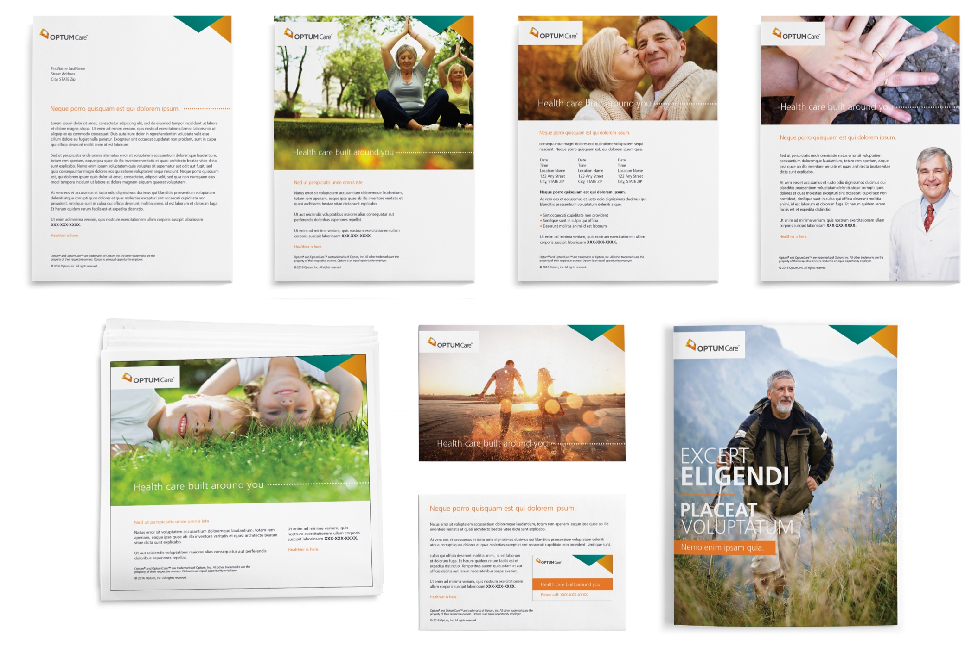
OptumCare – You Campaign

Slide 18
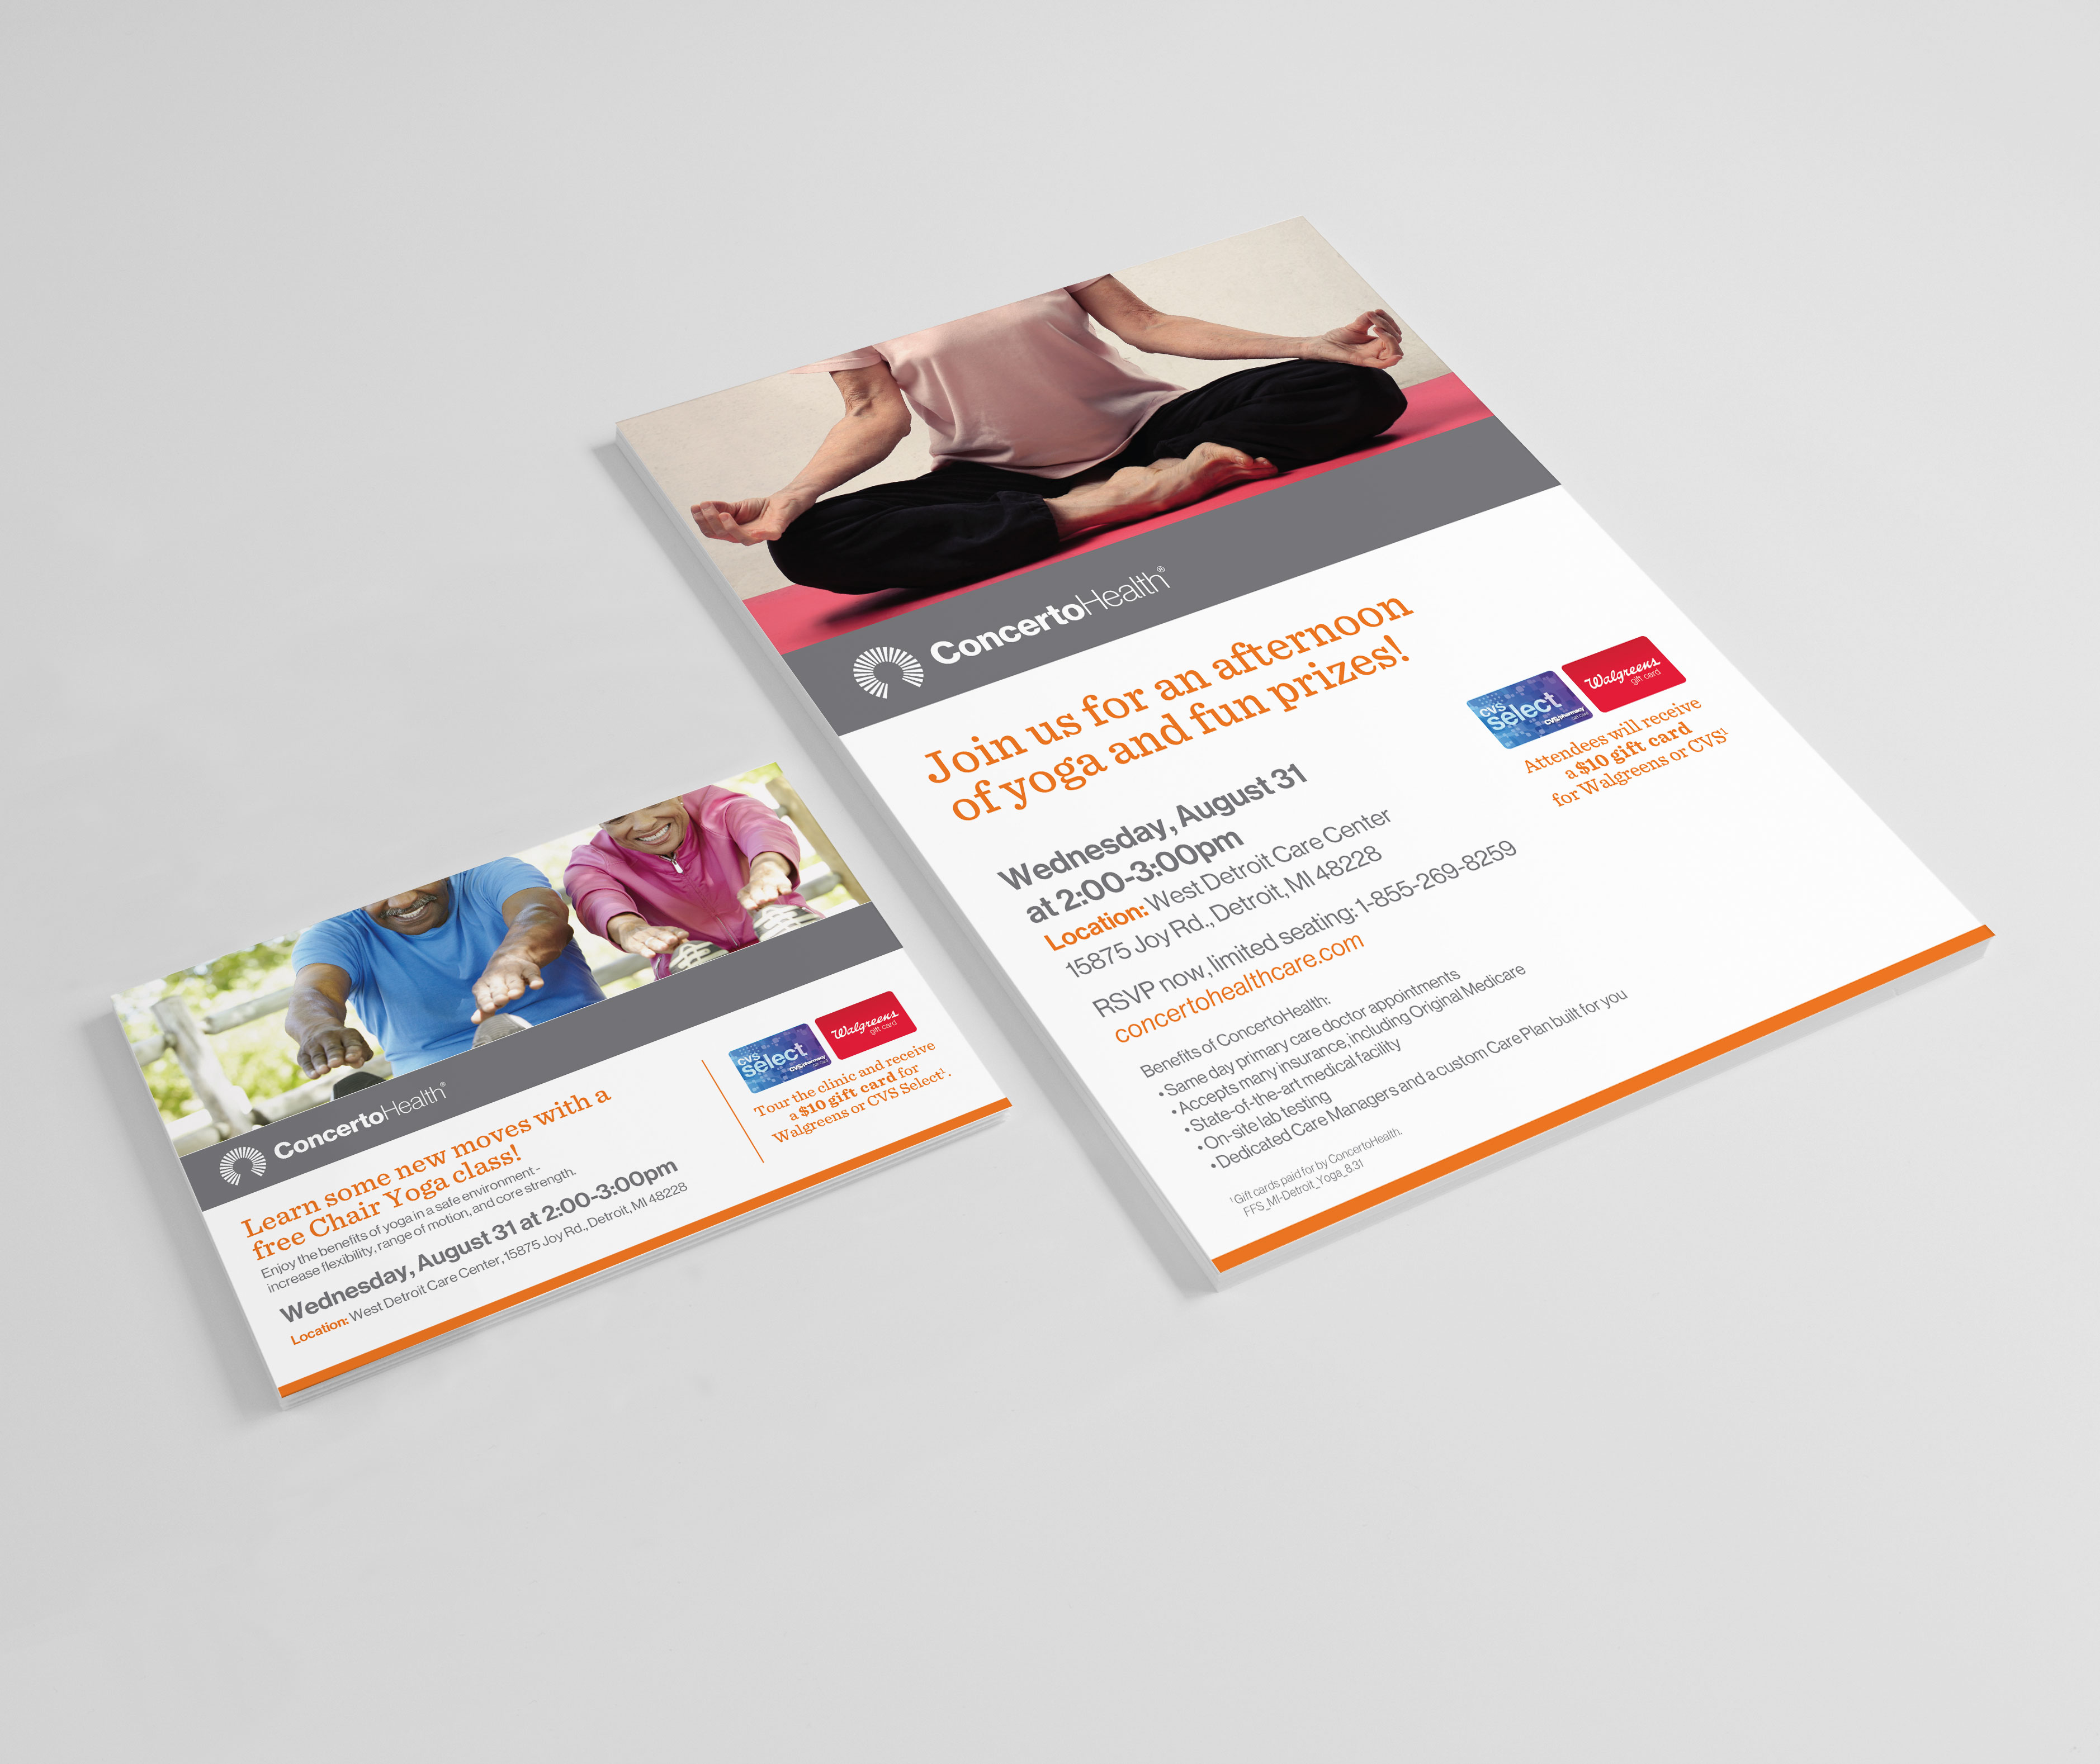
ConcertoHealth – Direct Mail / Event Support

Slide 19
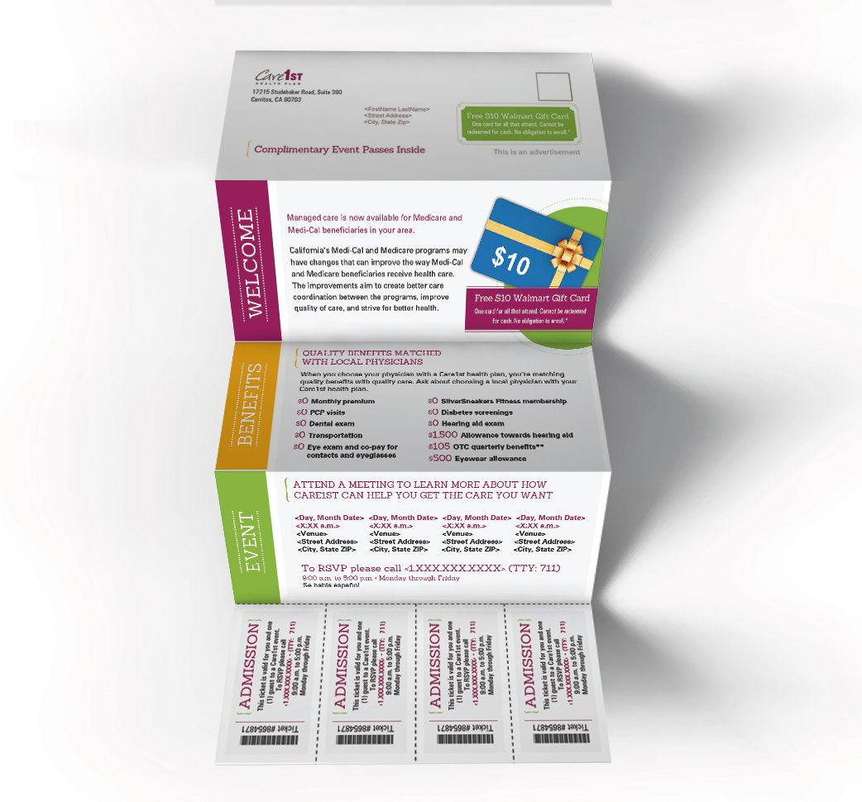

Slide 20
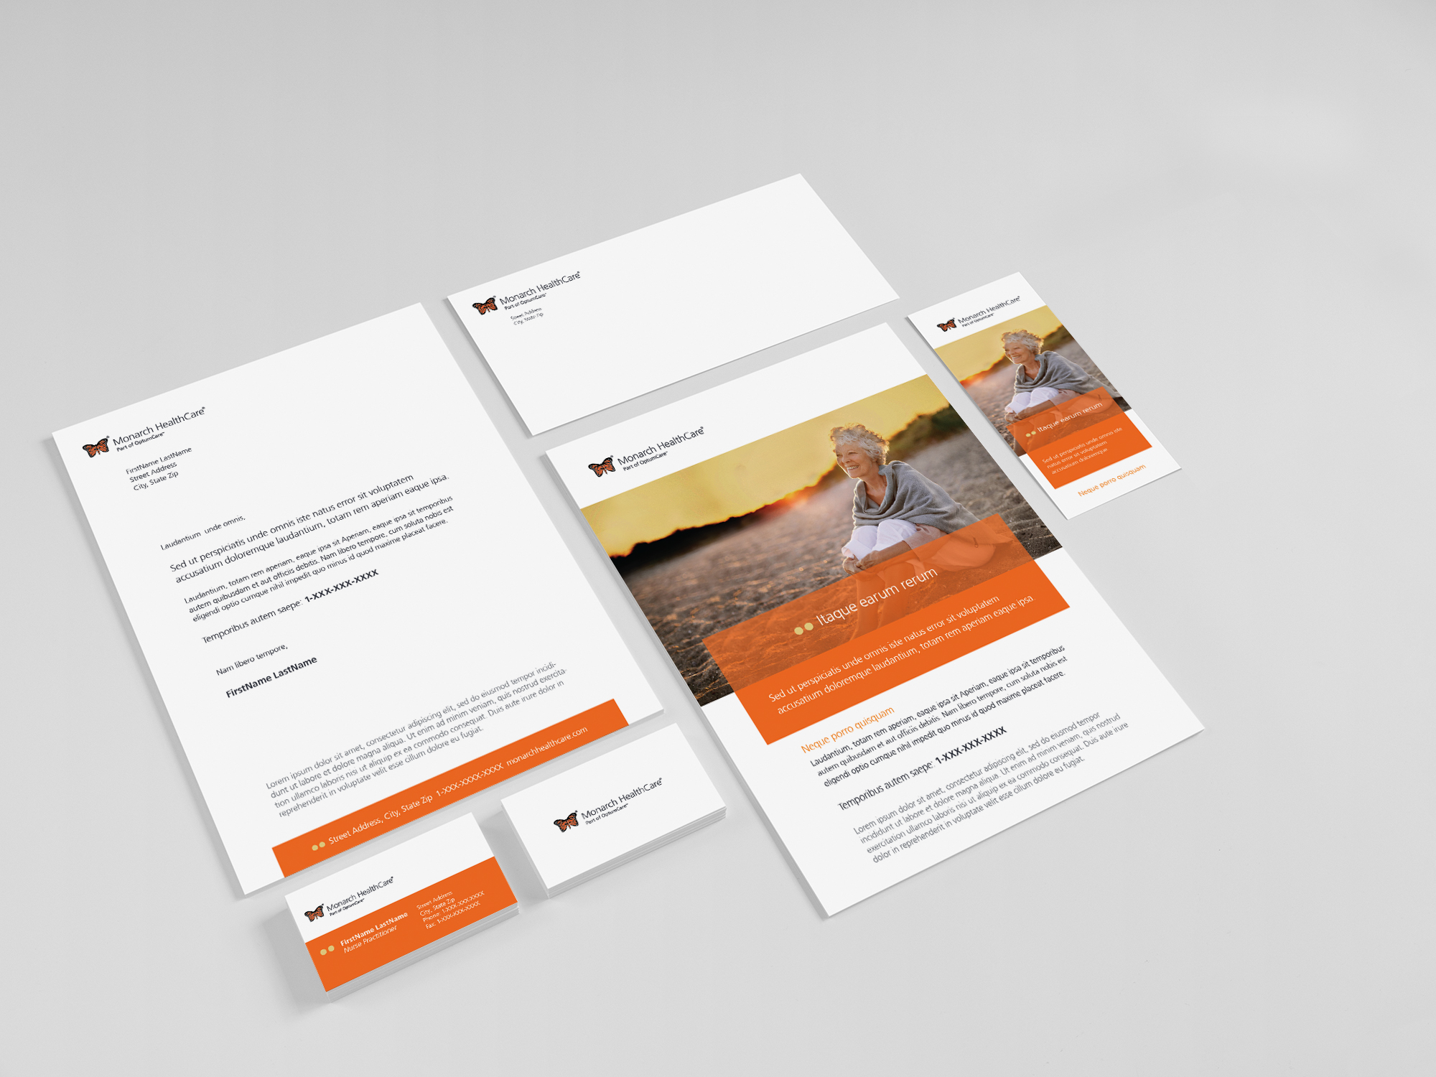
Refreshed options
Notes:
More personal

Slide 21
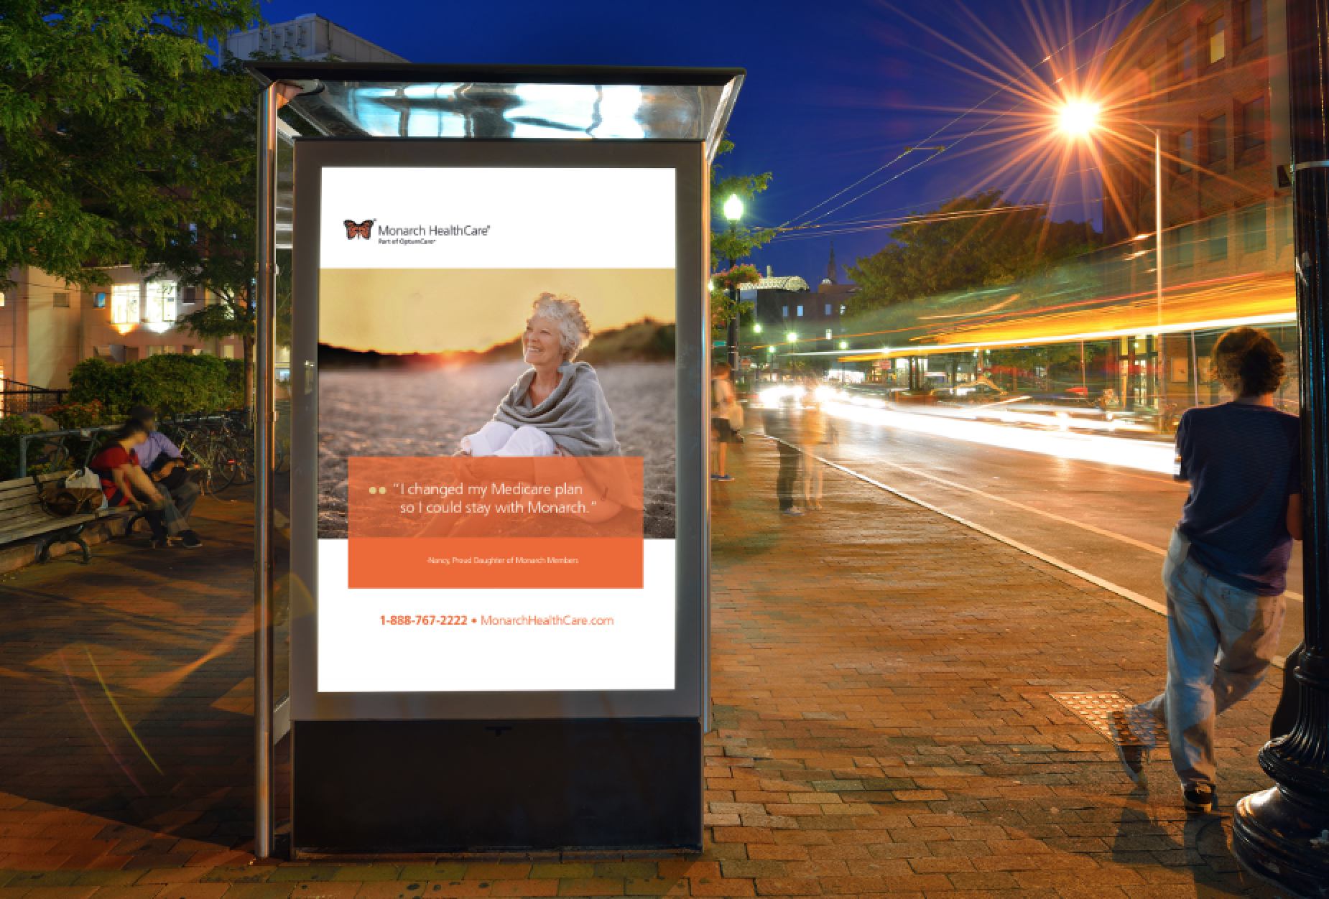
Refreshed options
Notes:
Pull words from their website for their descriptions – tie into their existing brand and how we landed on look and feel.
Modern and choice

Slide 22
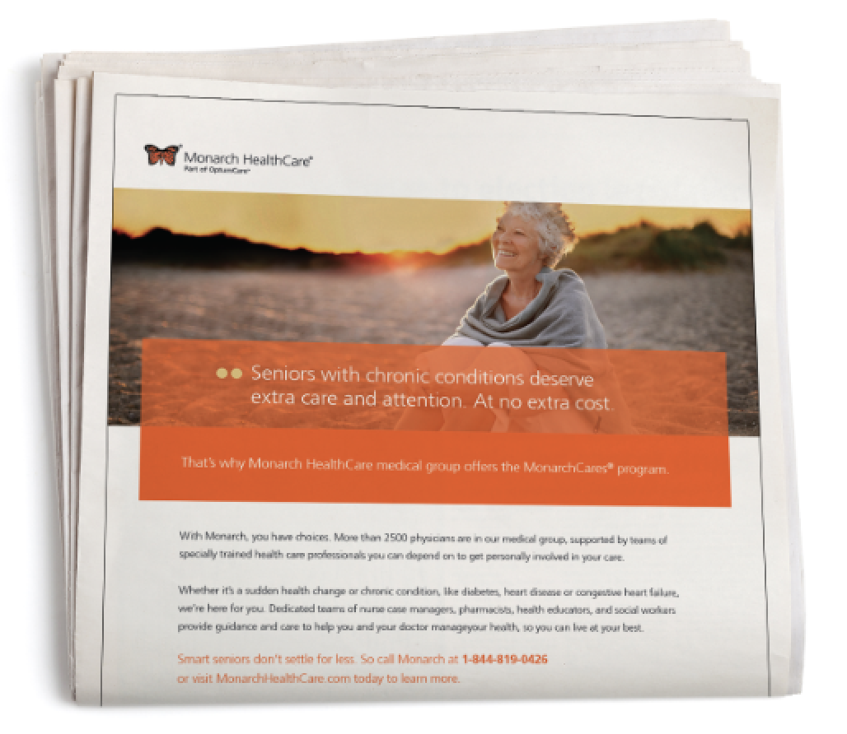
Notes:
Pull words from their website for their descriptions – tie into their existing brand and how we landed on look and feel.
Modern and choice

Slide 23
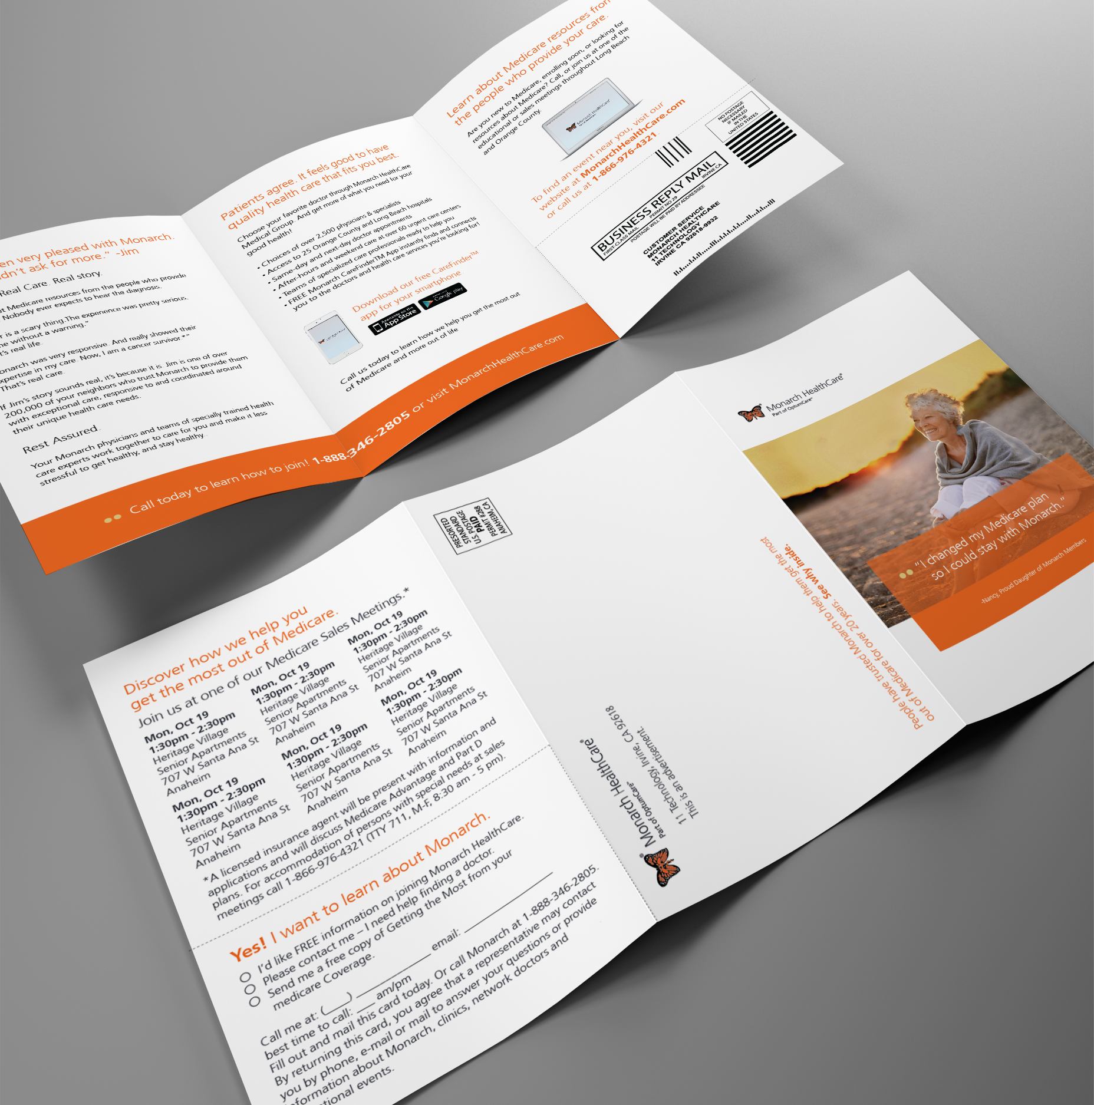
Notes:
Pull words from their website for their descriptions – tie into their existing brand and how we landed on look and feel.
Modern and choice

Slide 24
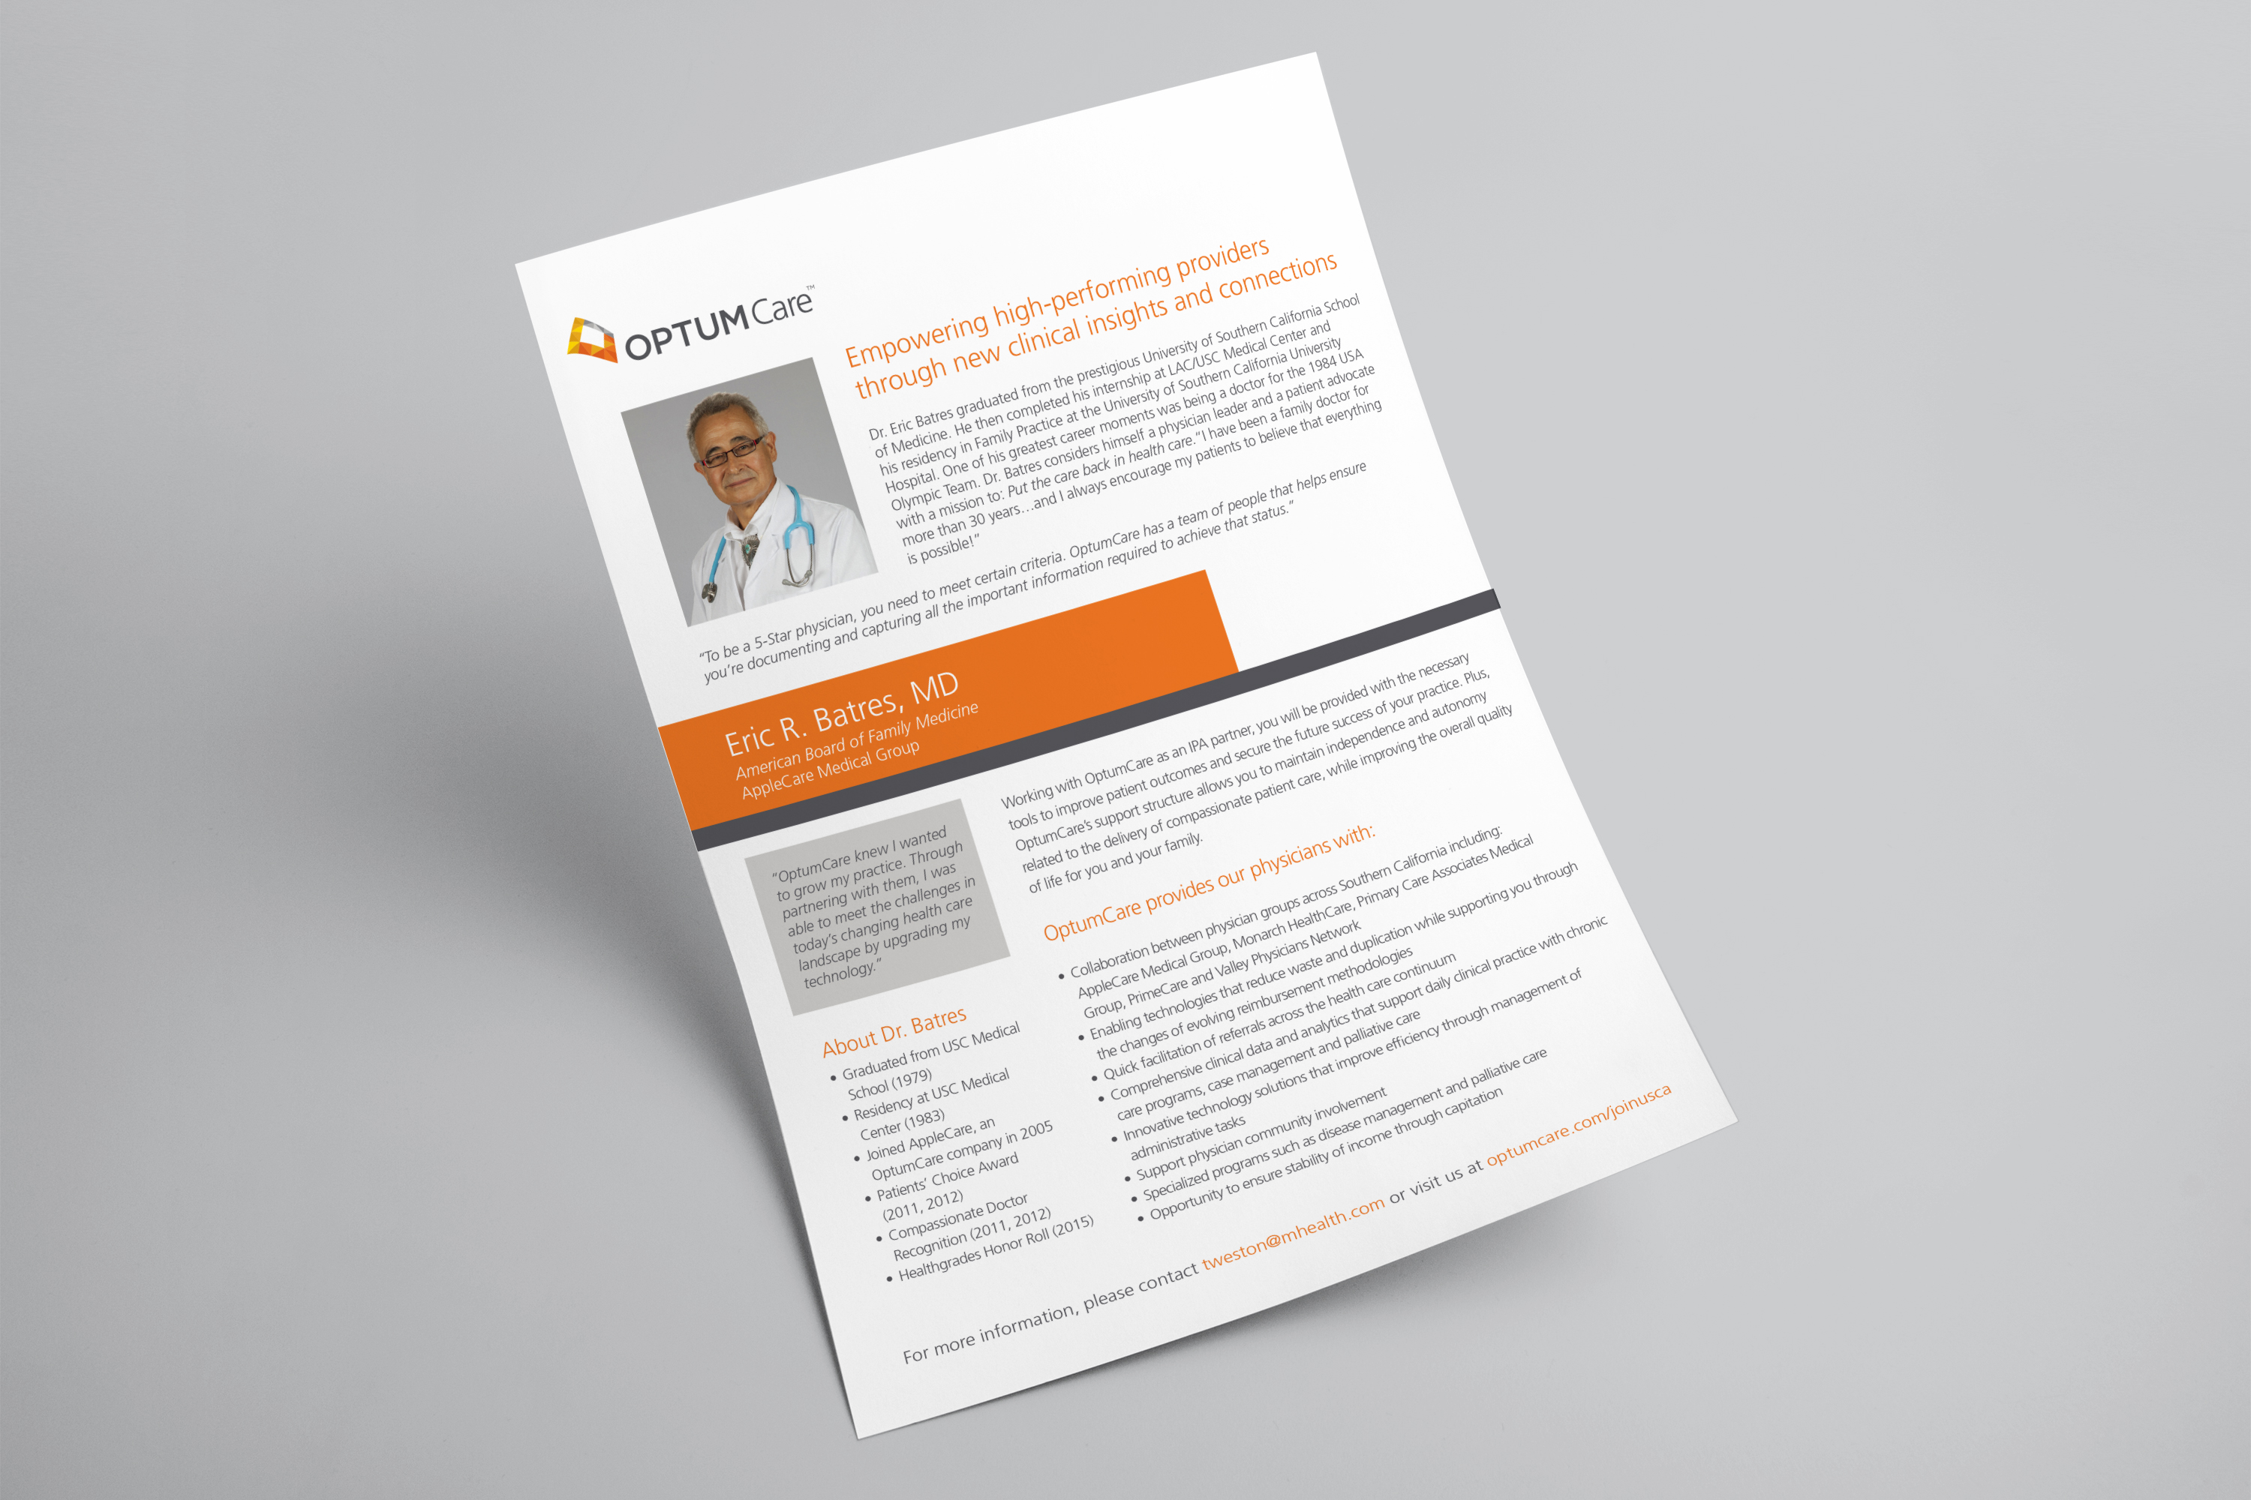

Slide 25
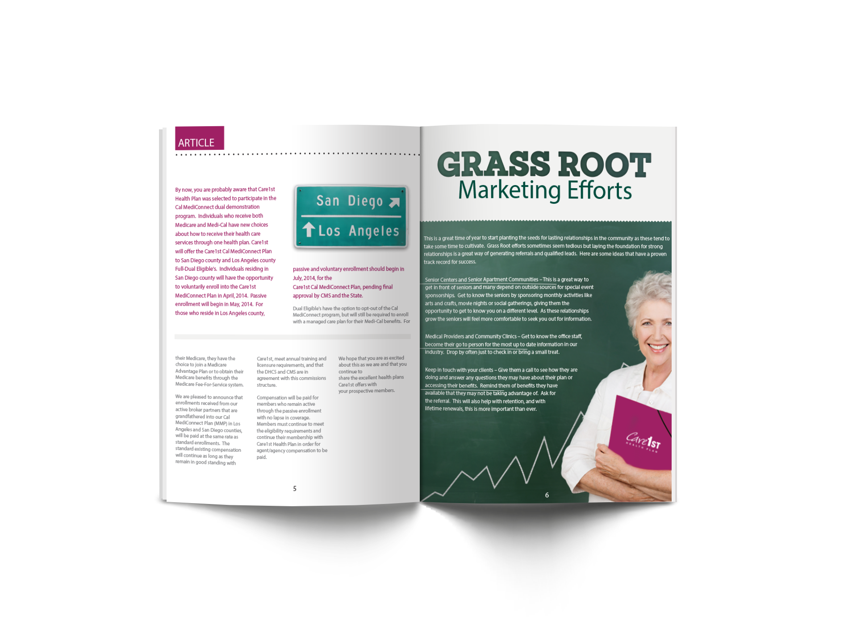
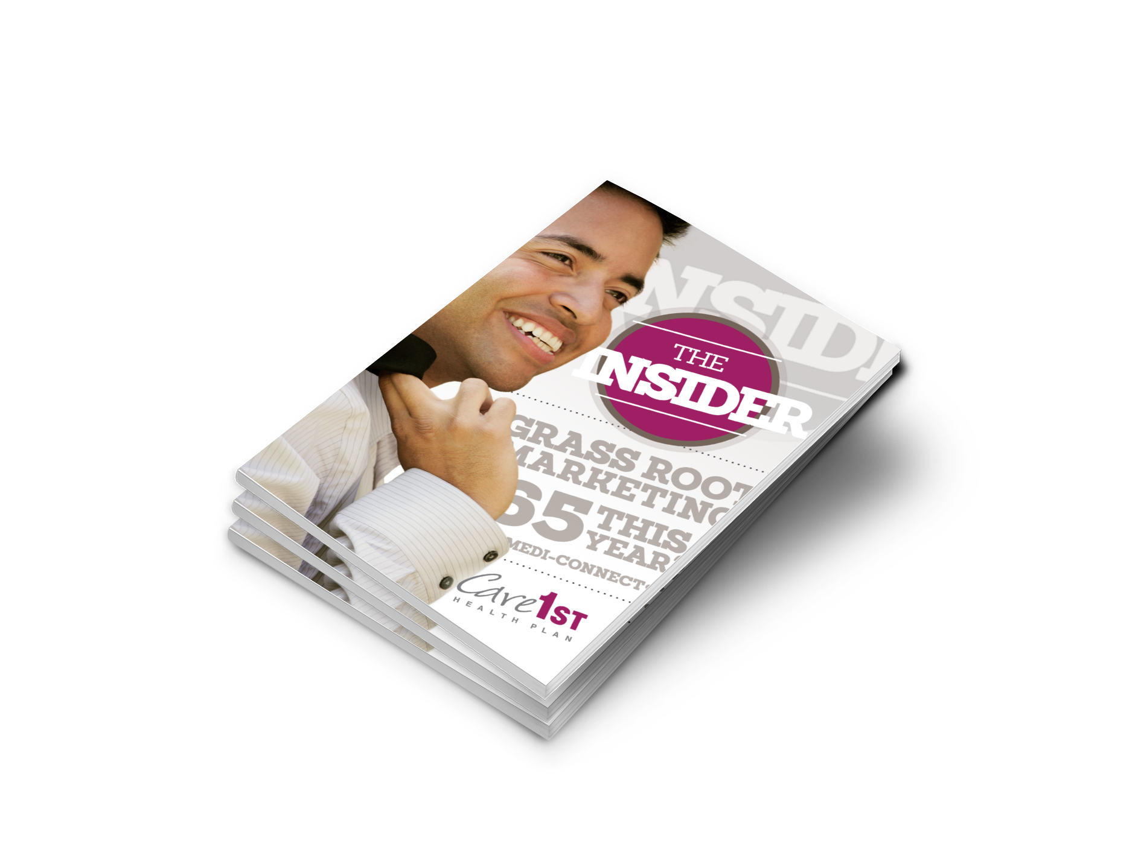

Slide 27
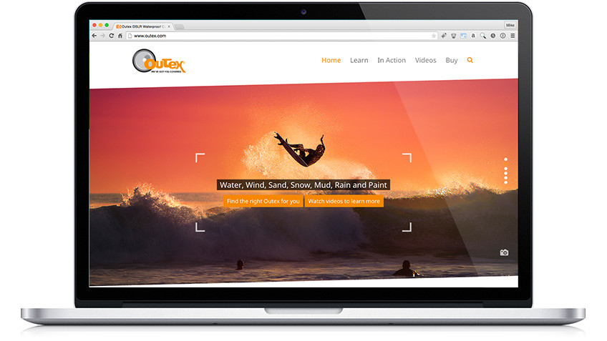
Outex www.outex.com
Parallax homepage
Instagram and other social integration tools
Shopify e-commerce integration http://store.outex.com/

Slide 28
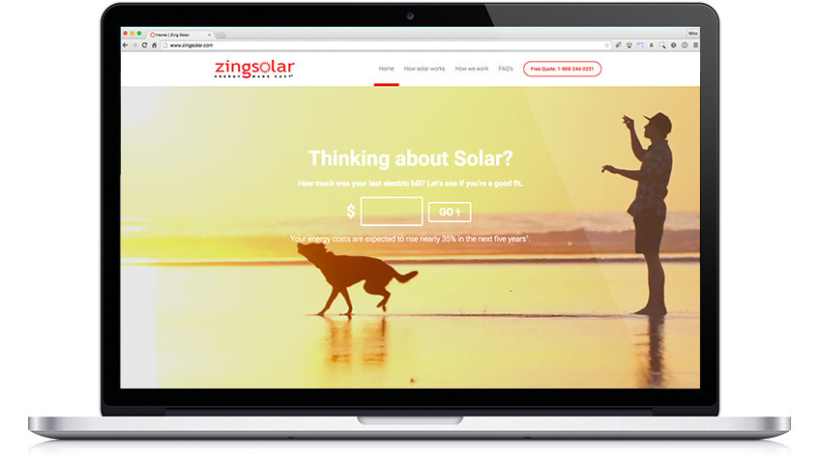
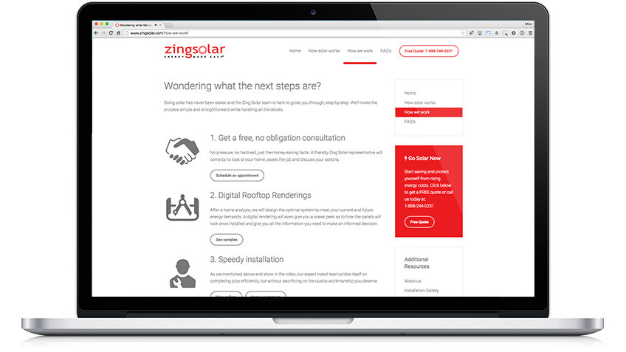
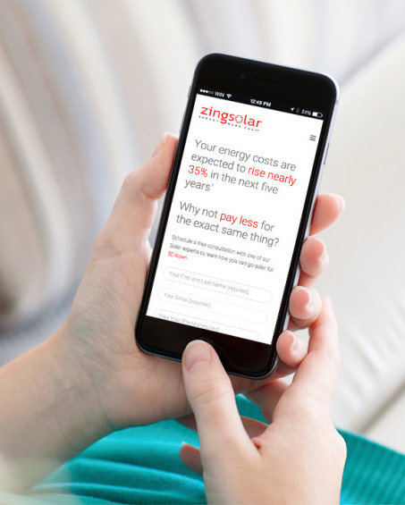
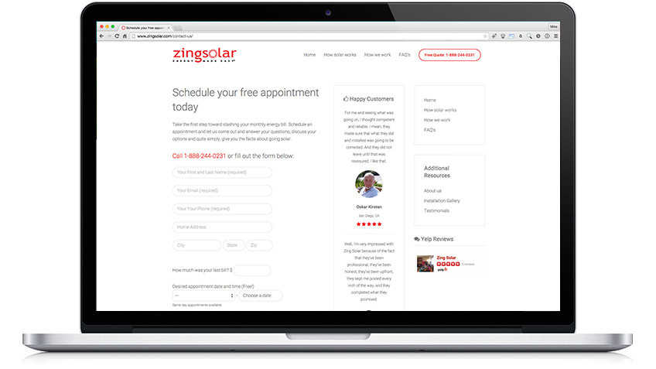
Zing Solar http://www.zingsolar.com/
Full screen video homepage with lead capture “enter your last bill”.
Interactive rooftop look-up, sends lead to call center.
Interactive cost saving calculator

Slide 29
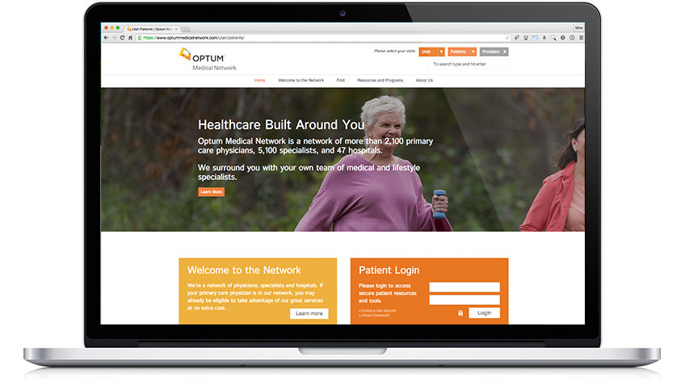
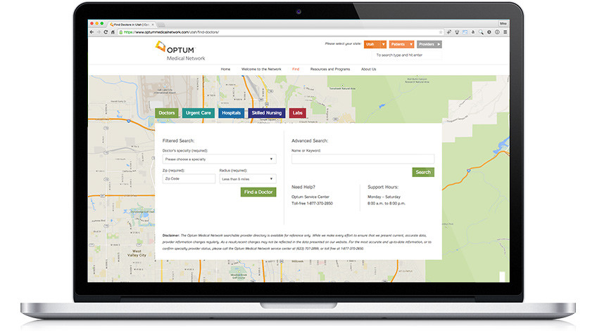
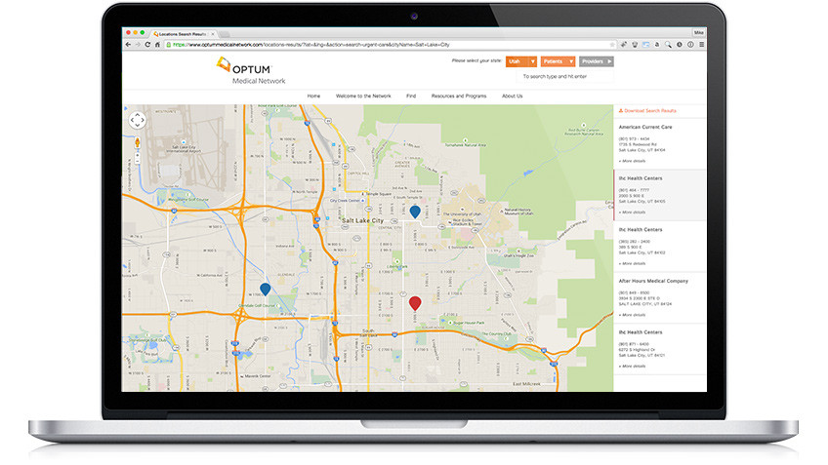
Optum Medical Network www.optummedicalnetwork.com
Provider look-up tool.
Interactive Homepage with Multi-state selection.
Physician and Patient portal.
Interactive Google map interface.

Slide 30
Notes:
Challenge
ForeSight, a cost containment company within the workers’ compensation industry, whose flagship offering FusionTM was in its infancy of
marketing materials, strategy and collateral development. Warm and cold proposals, which often require two or three in-person meetings, were
losing potential traction without cohesive and simple leave-behind materials. Prospects couldn’t recall the exact service offerings and benefits of
working with ForeSight due to the complex nature of their bill review process – which aggressively lowers the cost of surgical implants on workers’
compensation bills.
Solution
In our initial conversations, The Creative Department was able to evaluate the current brand landscape including web and print. Through this
review exercise, we determined that in addition to the branding improvements requested by ForeSight, the current marketing materials contained
large and complex presentations of the service benefits. While undertaking the brand overhaul, we’ve designed new flow-graphics to help illustrate
complex processes and stimulate faster process recall to constituents. Additionally, we’ve also improved messaging and headlines to condense a
full page of content into a simple statement of the value proposition; an average of 73% savings.
Outcome
Re-launching this fall, the new ForeSight brand will continue to build its platform of reputable industry principles, board leaders, and investors with
a focused marketing strategy driving their growth. Deployment will consist of a new web site, sales collateral, flow-charts, trade show booths, and
other marketing support tactics that specifically target their primary constituents.

Slide 31
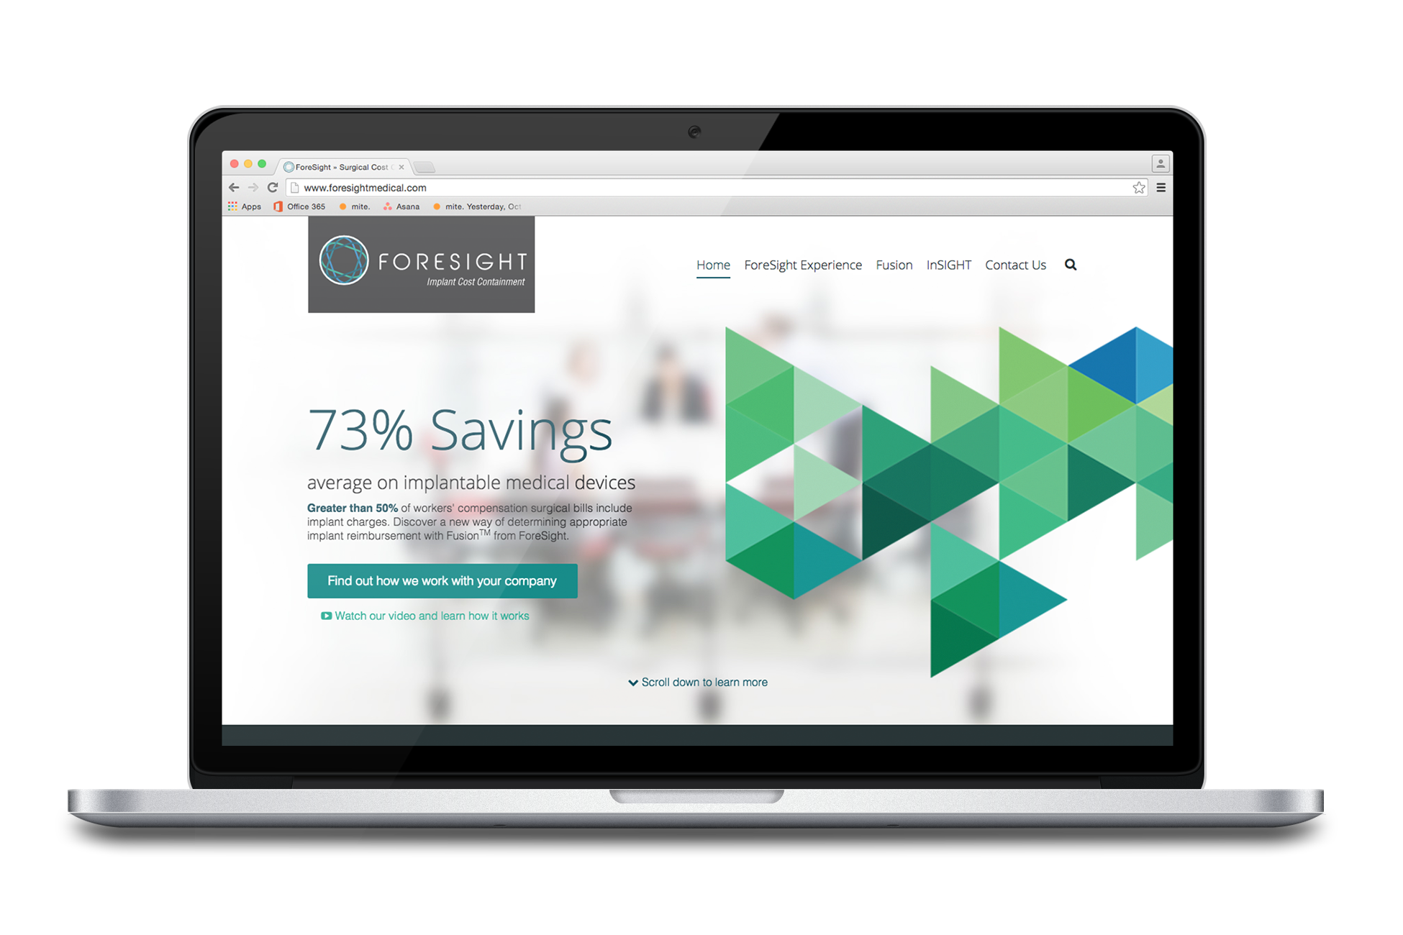

Slide 32
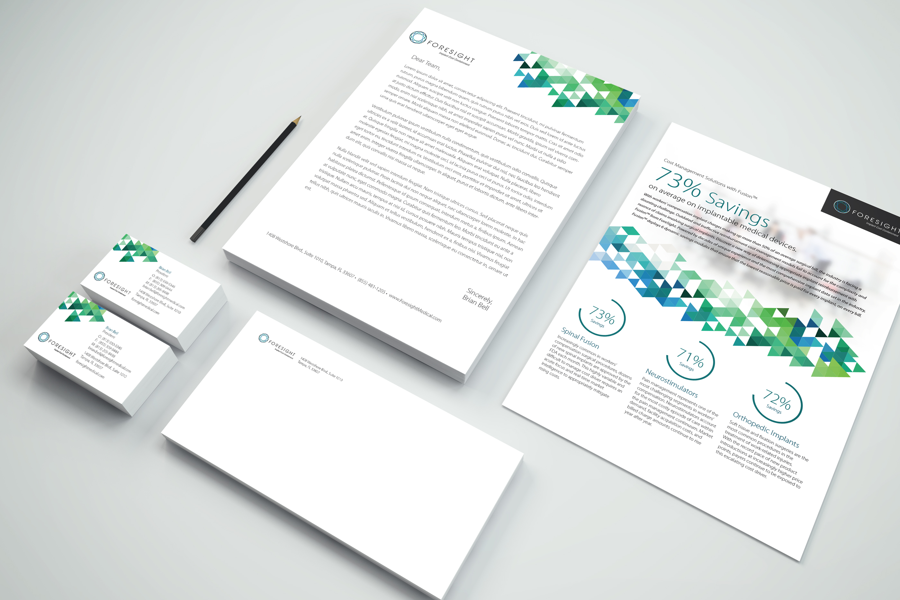

Slide 34
